Slide 1
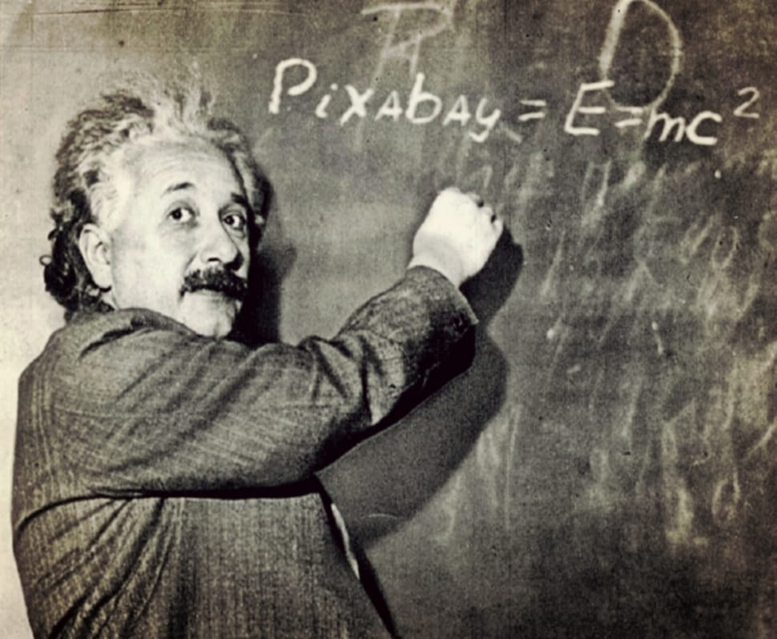
Einstein’s Theory
on relativity

Slide 2
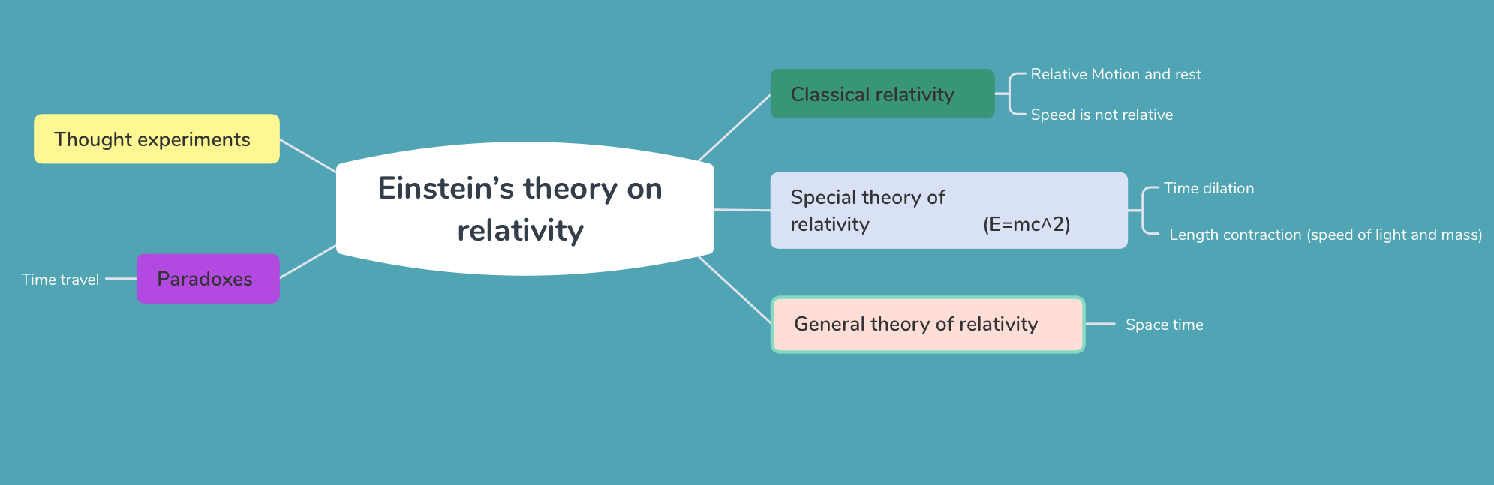
OUR TOPICS FOR TODAY…..

Slide 3
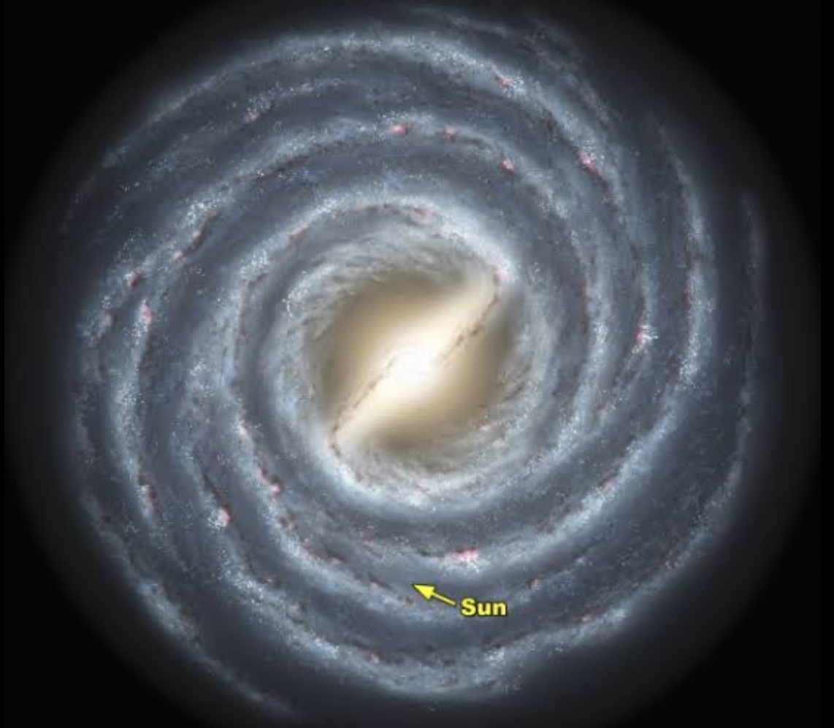
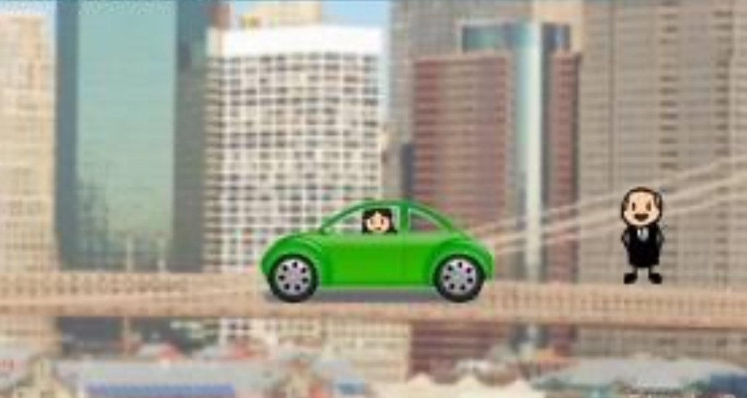
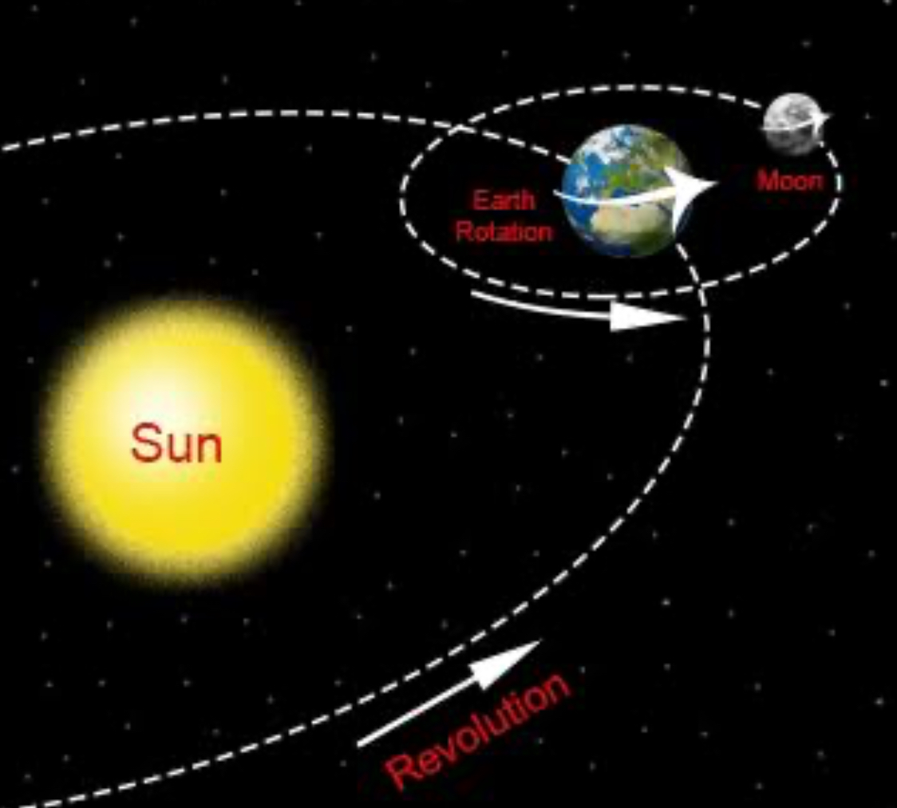
classical relativity:
CLASSICAL RELATIVITY STATES THAT ; Rest and motion are always relative to the observers state of motion. A body cannot exist at a state of absolute rest or absolute motion. Therefore , distance and time are relative to speed.
Car - 65kmph,
observer - 0 kmph
Relating to the earth's rotation/revolution
The sun’s/ solar system’s movement around Milky Way.

Slide 4

*However, classical relativity breaks down at the speed of light. This means that light travels at the same velocity regardless of the viewer’s perspective.

Slide 5
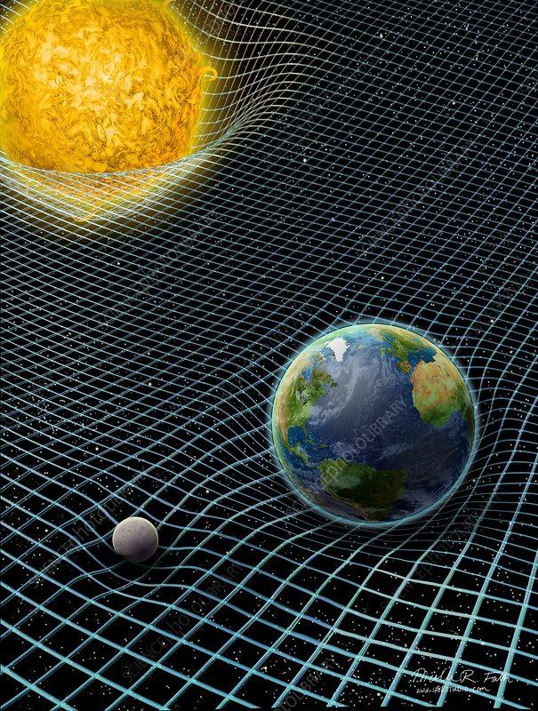
General theory of relativity
General theory of relativity states that anything which has mass bends space time. As sun has more mass than earth it bends more space time and it has a bigger gravitational pull than earth’s.

Slide 6
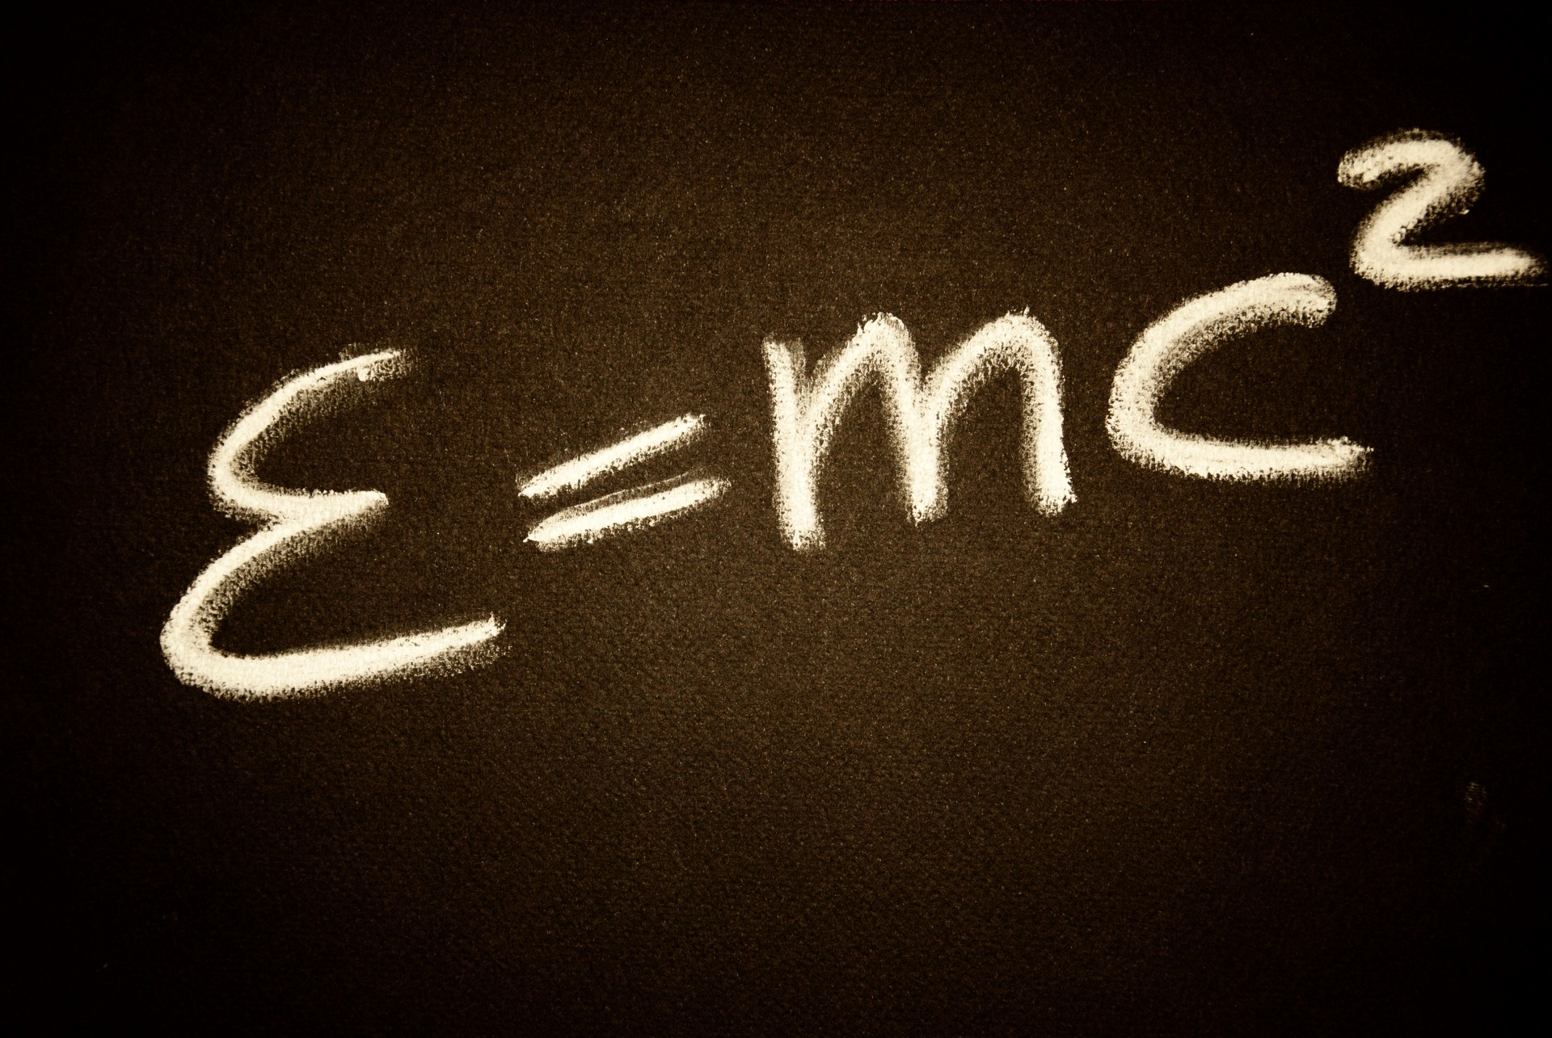
In physics mass-energy equivalence is the principle that anything having a mass has an equivalent amount of energy and vice versa therefore both of them are interchangeable.
1kg of mass =9×10to the power of six joules of energy which is equal to 21 megaton of TNT. 99 megatons of TNT is enough to destroy the earth.In simple words 4.7 kgs of mass is enough to destroy the Earth.

Slide 7
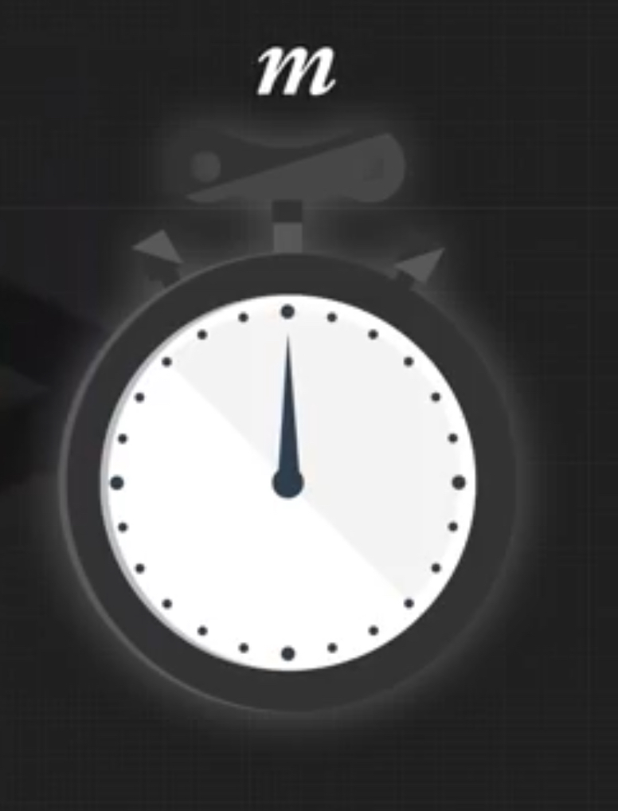


Even though both watches weigh exactly the same, the watch in motion contains more mass than the watch at rest , as it has more kinetic energy and potential energy.

Slide 8
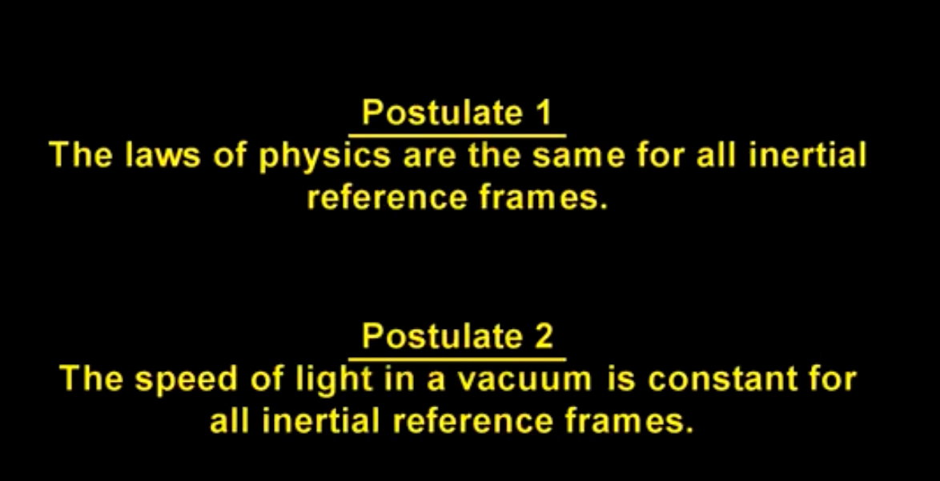
Special Theory of Relativity
Special theory of relativity is the relationship between space and time for a object travelling at a consistent speed. One of its main aspects concerns the speed of light.

Slide 9
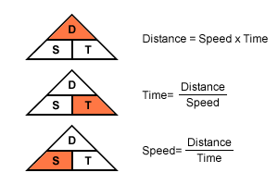
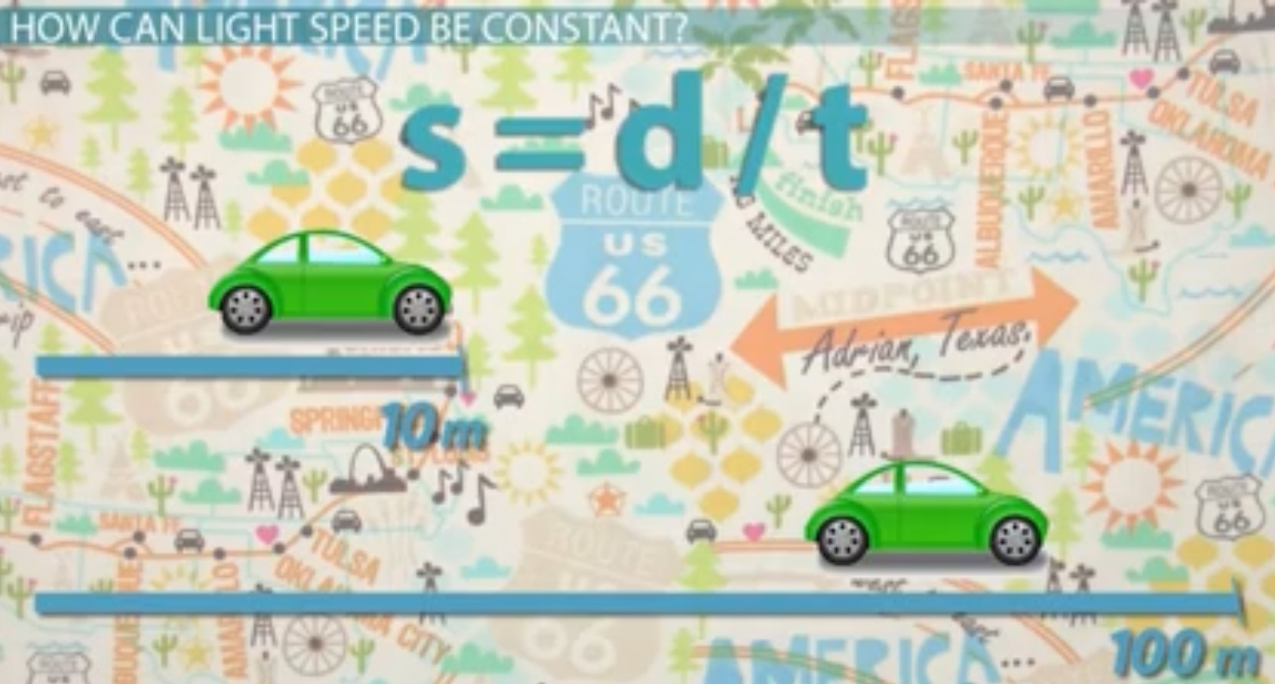
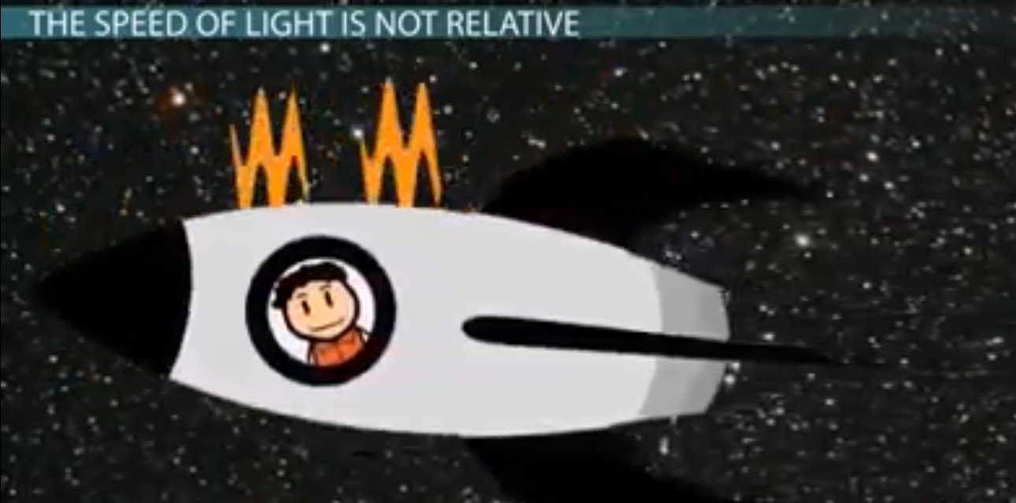
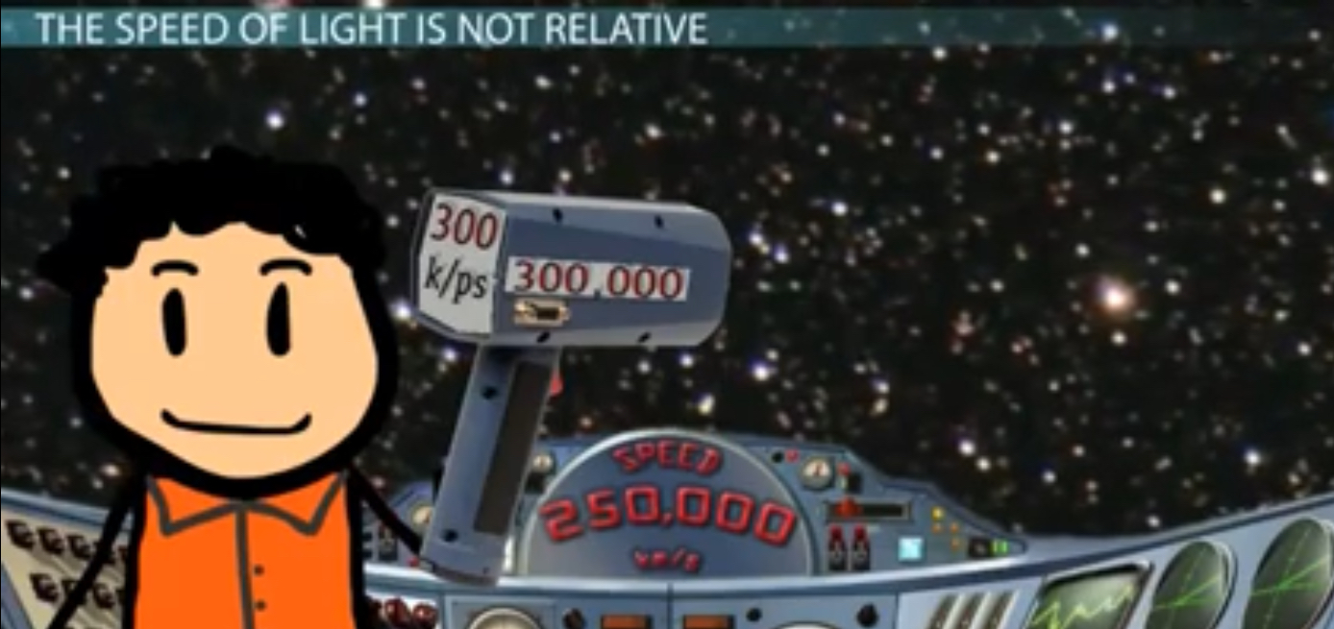
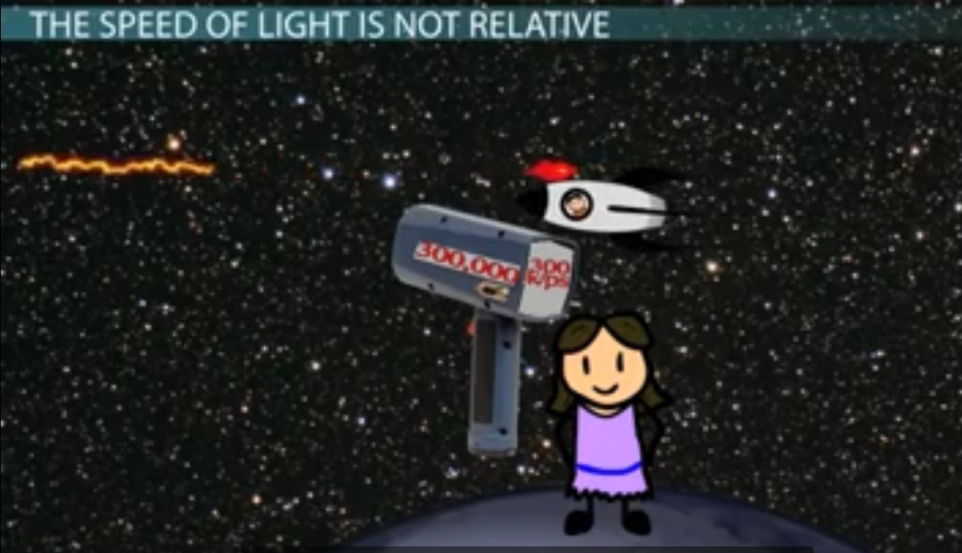
As speed= distance/time, we know that the speed of light is constant as distance and time is relative to speed. Therefore for light if you change the distance and time the speed remains the same!

Slide 10

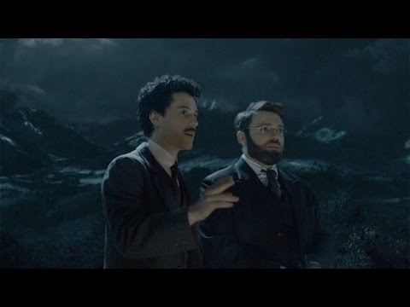
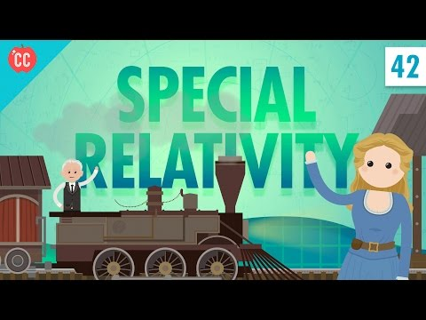
Time dilation
Time dilation is a elapsed difference measured by two clocks.
Difference in their velocity
Gravitational potential difference
In simple words:-
The rate at which time passes is different depending on how fast your moving and how much you are accelerating.

Slide 11
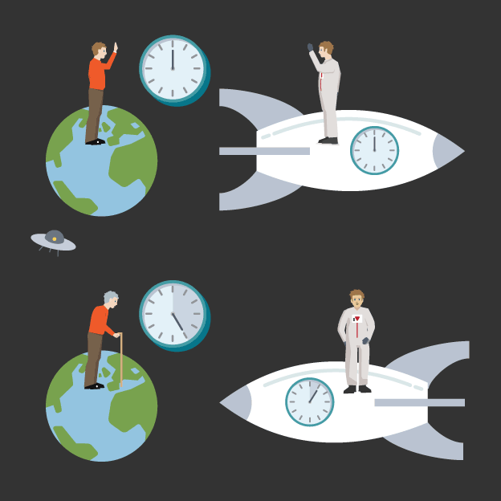
Twin paradox explained

Slide 12
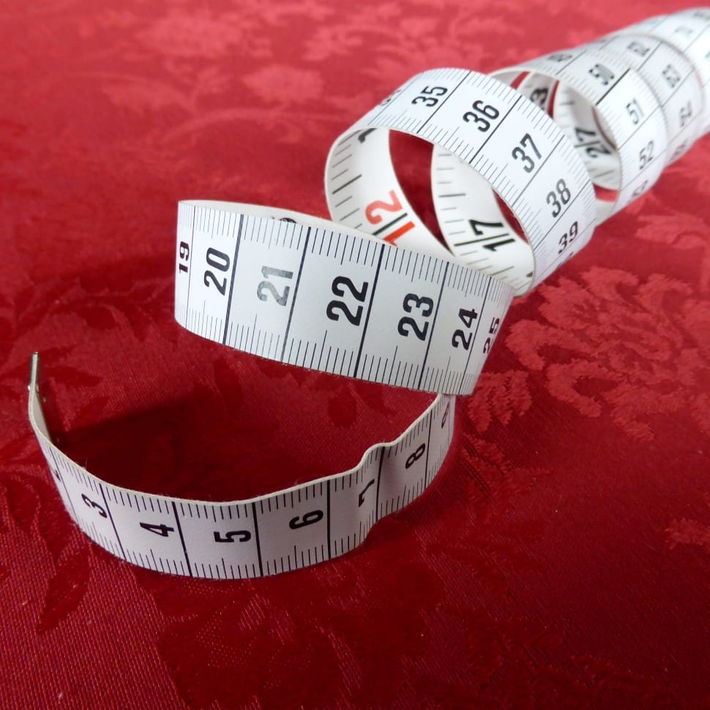
Length Contraction
so special relativity tells us that because light travels at the same speed, time dilates and length contracts to compensate.
Time slows down at high speeds therefore the distance shortens!
If something is moving relative to you ,it’s length in the direction it’s moving to will seem shorter than it would if it was not moving relative to you.

Slide 13
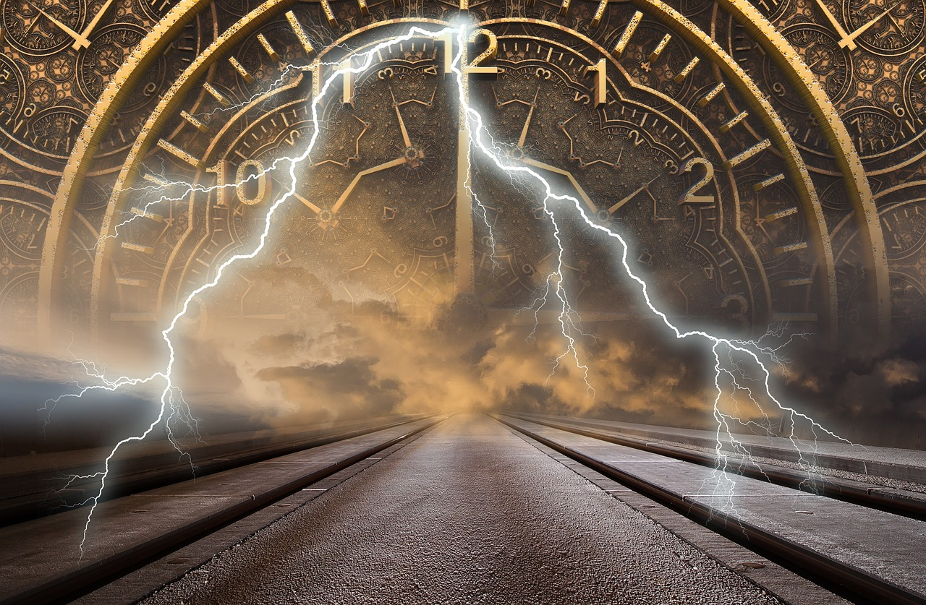
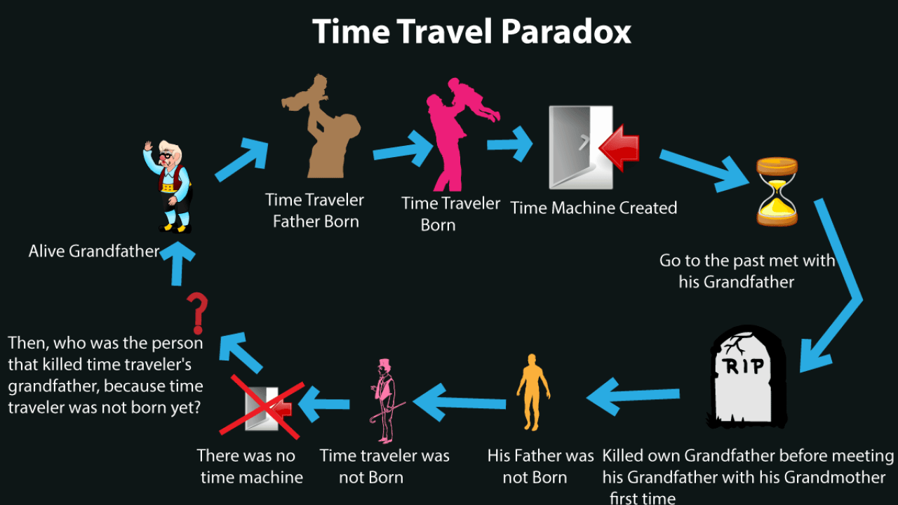
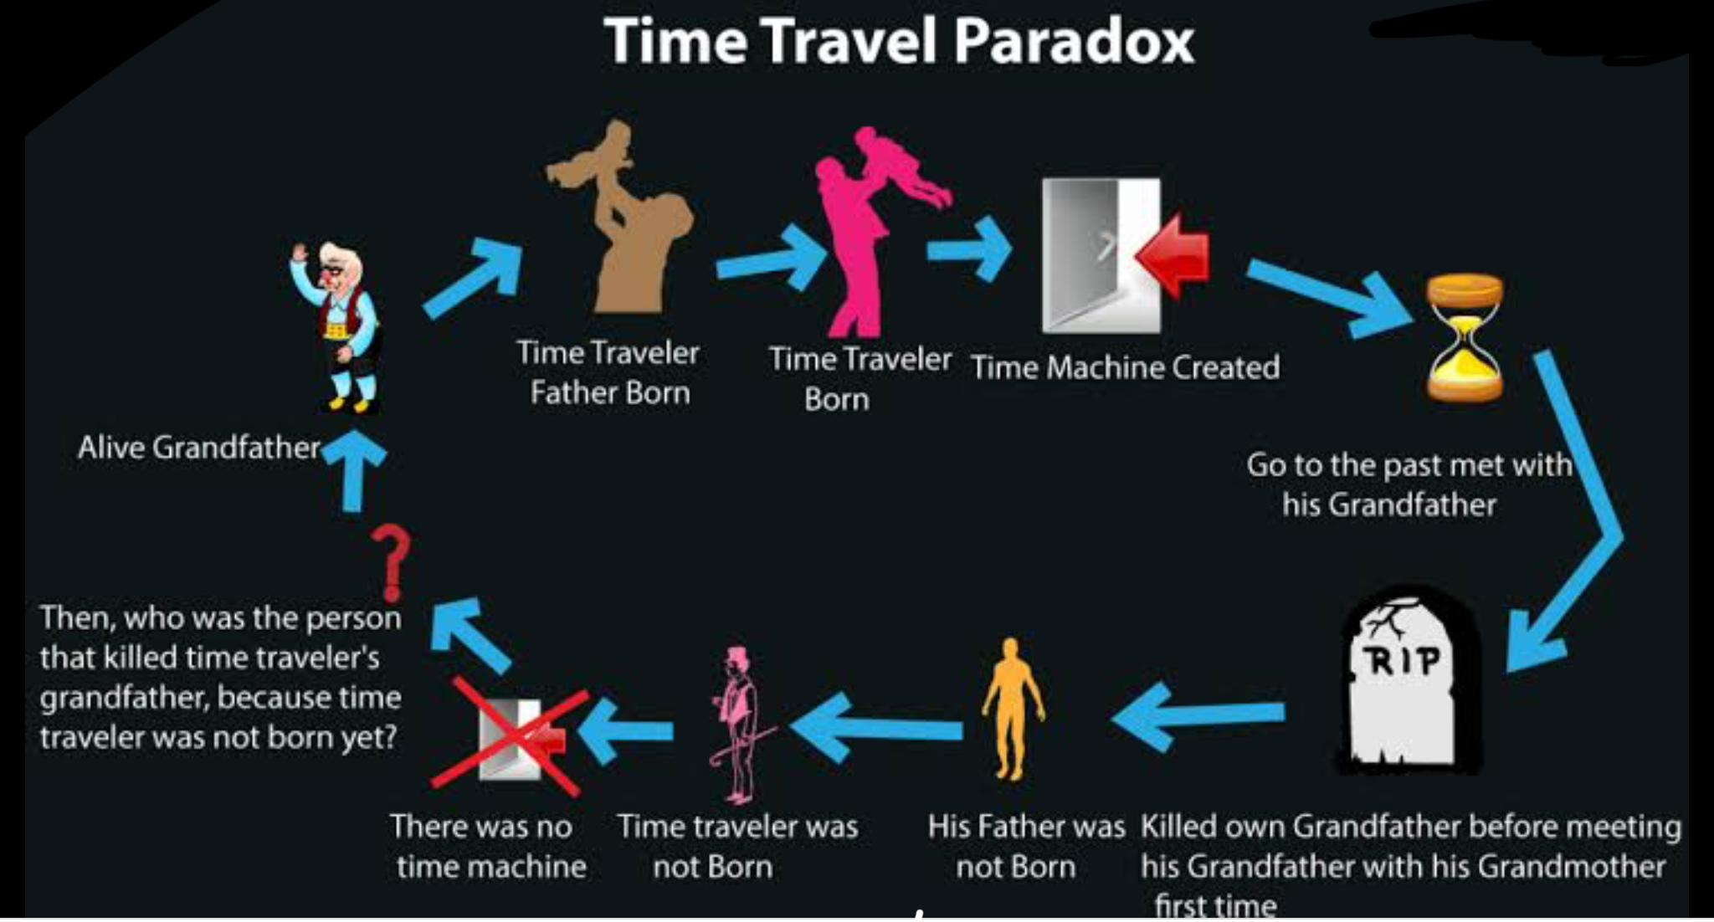
Paradoxes:
TIME TRAVEL PARADOX :
General relativity says that time travel is possible if an object is travelling at a speed faster,than the speed of light.
Some people say that if time travel was possible then there would be some logical errors,or contradictions.

Slide 14
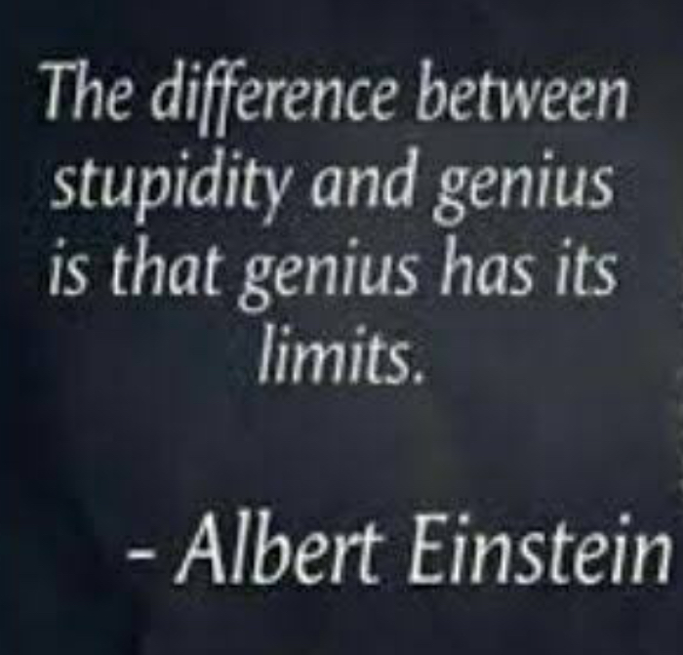
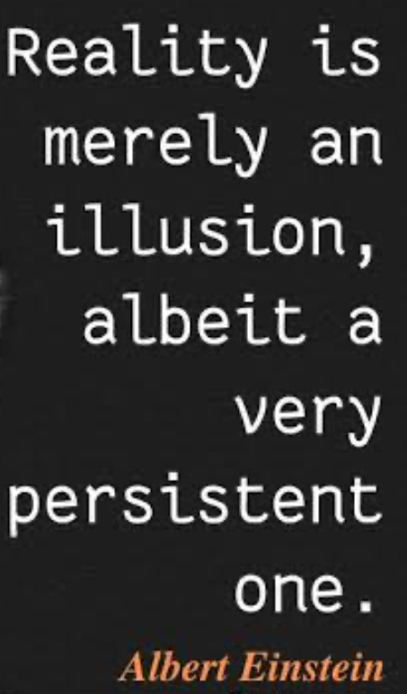


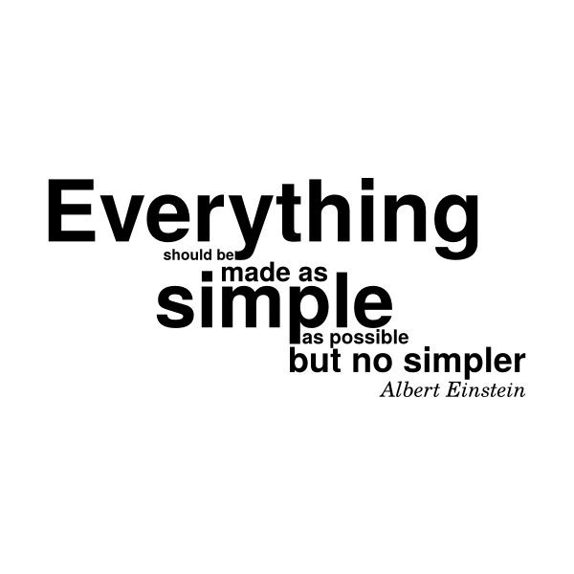
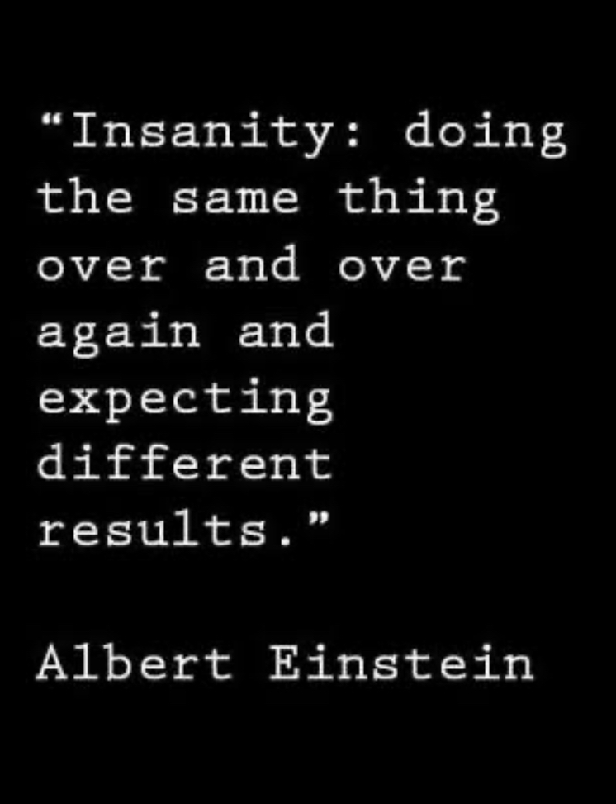
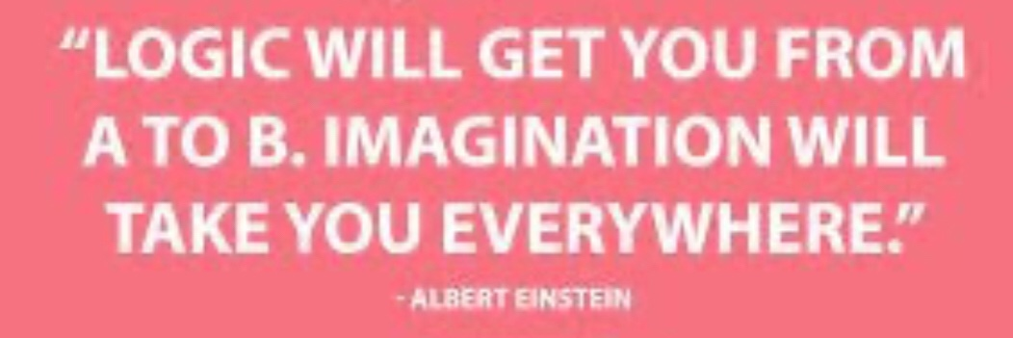
If you can't explain it simply, you don't understand it well enough.
-Albert Einstein
i(Hope we have understood it)

Slide 15
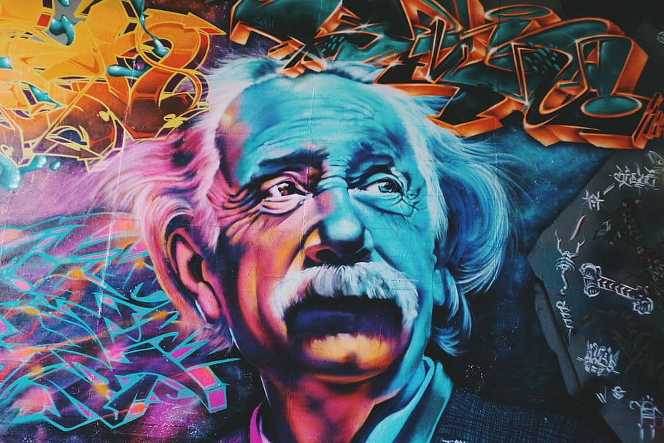
THANKYOU!

